Slide 1
KHULNA UNIVERSITY OF ENGINEERING & TECHNOLOGY (KUET)
Department of Computer Science and Engineering
3D Virtual Architectural Walkthrough:
Khan Jahan Ali Hall Room
Course: CSE 4102 · Computer Graphics and Image Processing Laboratory
SUBMITTED BY
SUPERVISED BY
Mehedi Hasan Rabby
Roll: 2107086
Year: 4th · Term: 1st · Session: 2024–25
Department of Computer Science and Engineering
Khulna University of Engineering & Technology
Mr Md. Tajmilur Rahman
Lecturer, Dept of CSE, KUET
Mr Md. Mubtashim Abrar Nihal
Lecturer, Dept of CSE, KUET
Dept of CSE, KUET · October 2026
CSE 4102: Computer Graphics & Image Processing Lab
01 / 10

Slide 2
Presentation Outline
Core technical milestones and architecture overview
01
Introduction & Architectural Scene
Room collegiate dorm, hallway corridor, and campus sports complex layout
02
Procedural Primitive Computation
Mathematical parametric formulas for Unit Cube, UV Sphere, and Capped Cylinder
03
Transformations & Camera Navigation
Hierarchical Model-View-Projection pipeline and first-person portal navigation
04
Multi-Source Illumination Model
Vector Phong reflection equations, 6 distance-attenuated point lights, and sun
05
Shading Modes: Gouraud vs. Phong
Side-by-side shader evaluation and specular highlight fidelity comparison
06
Dynamic Kinematics & Animations
Smooth exponential door opening, dual-motion table fan, and switchboard LEDs
07
Verification & Live Demonstration
High-resolution rendering results, performance benchmarks, and live defense guide
Dept of CSE, KUET · October 2026
CSE 4102: Computer Graphics & Image Processing Lab
02 / 10

Slide 3
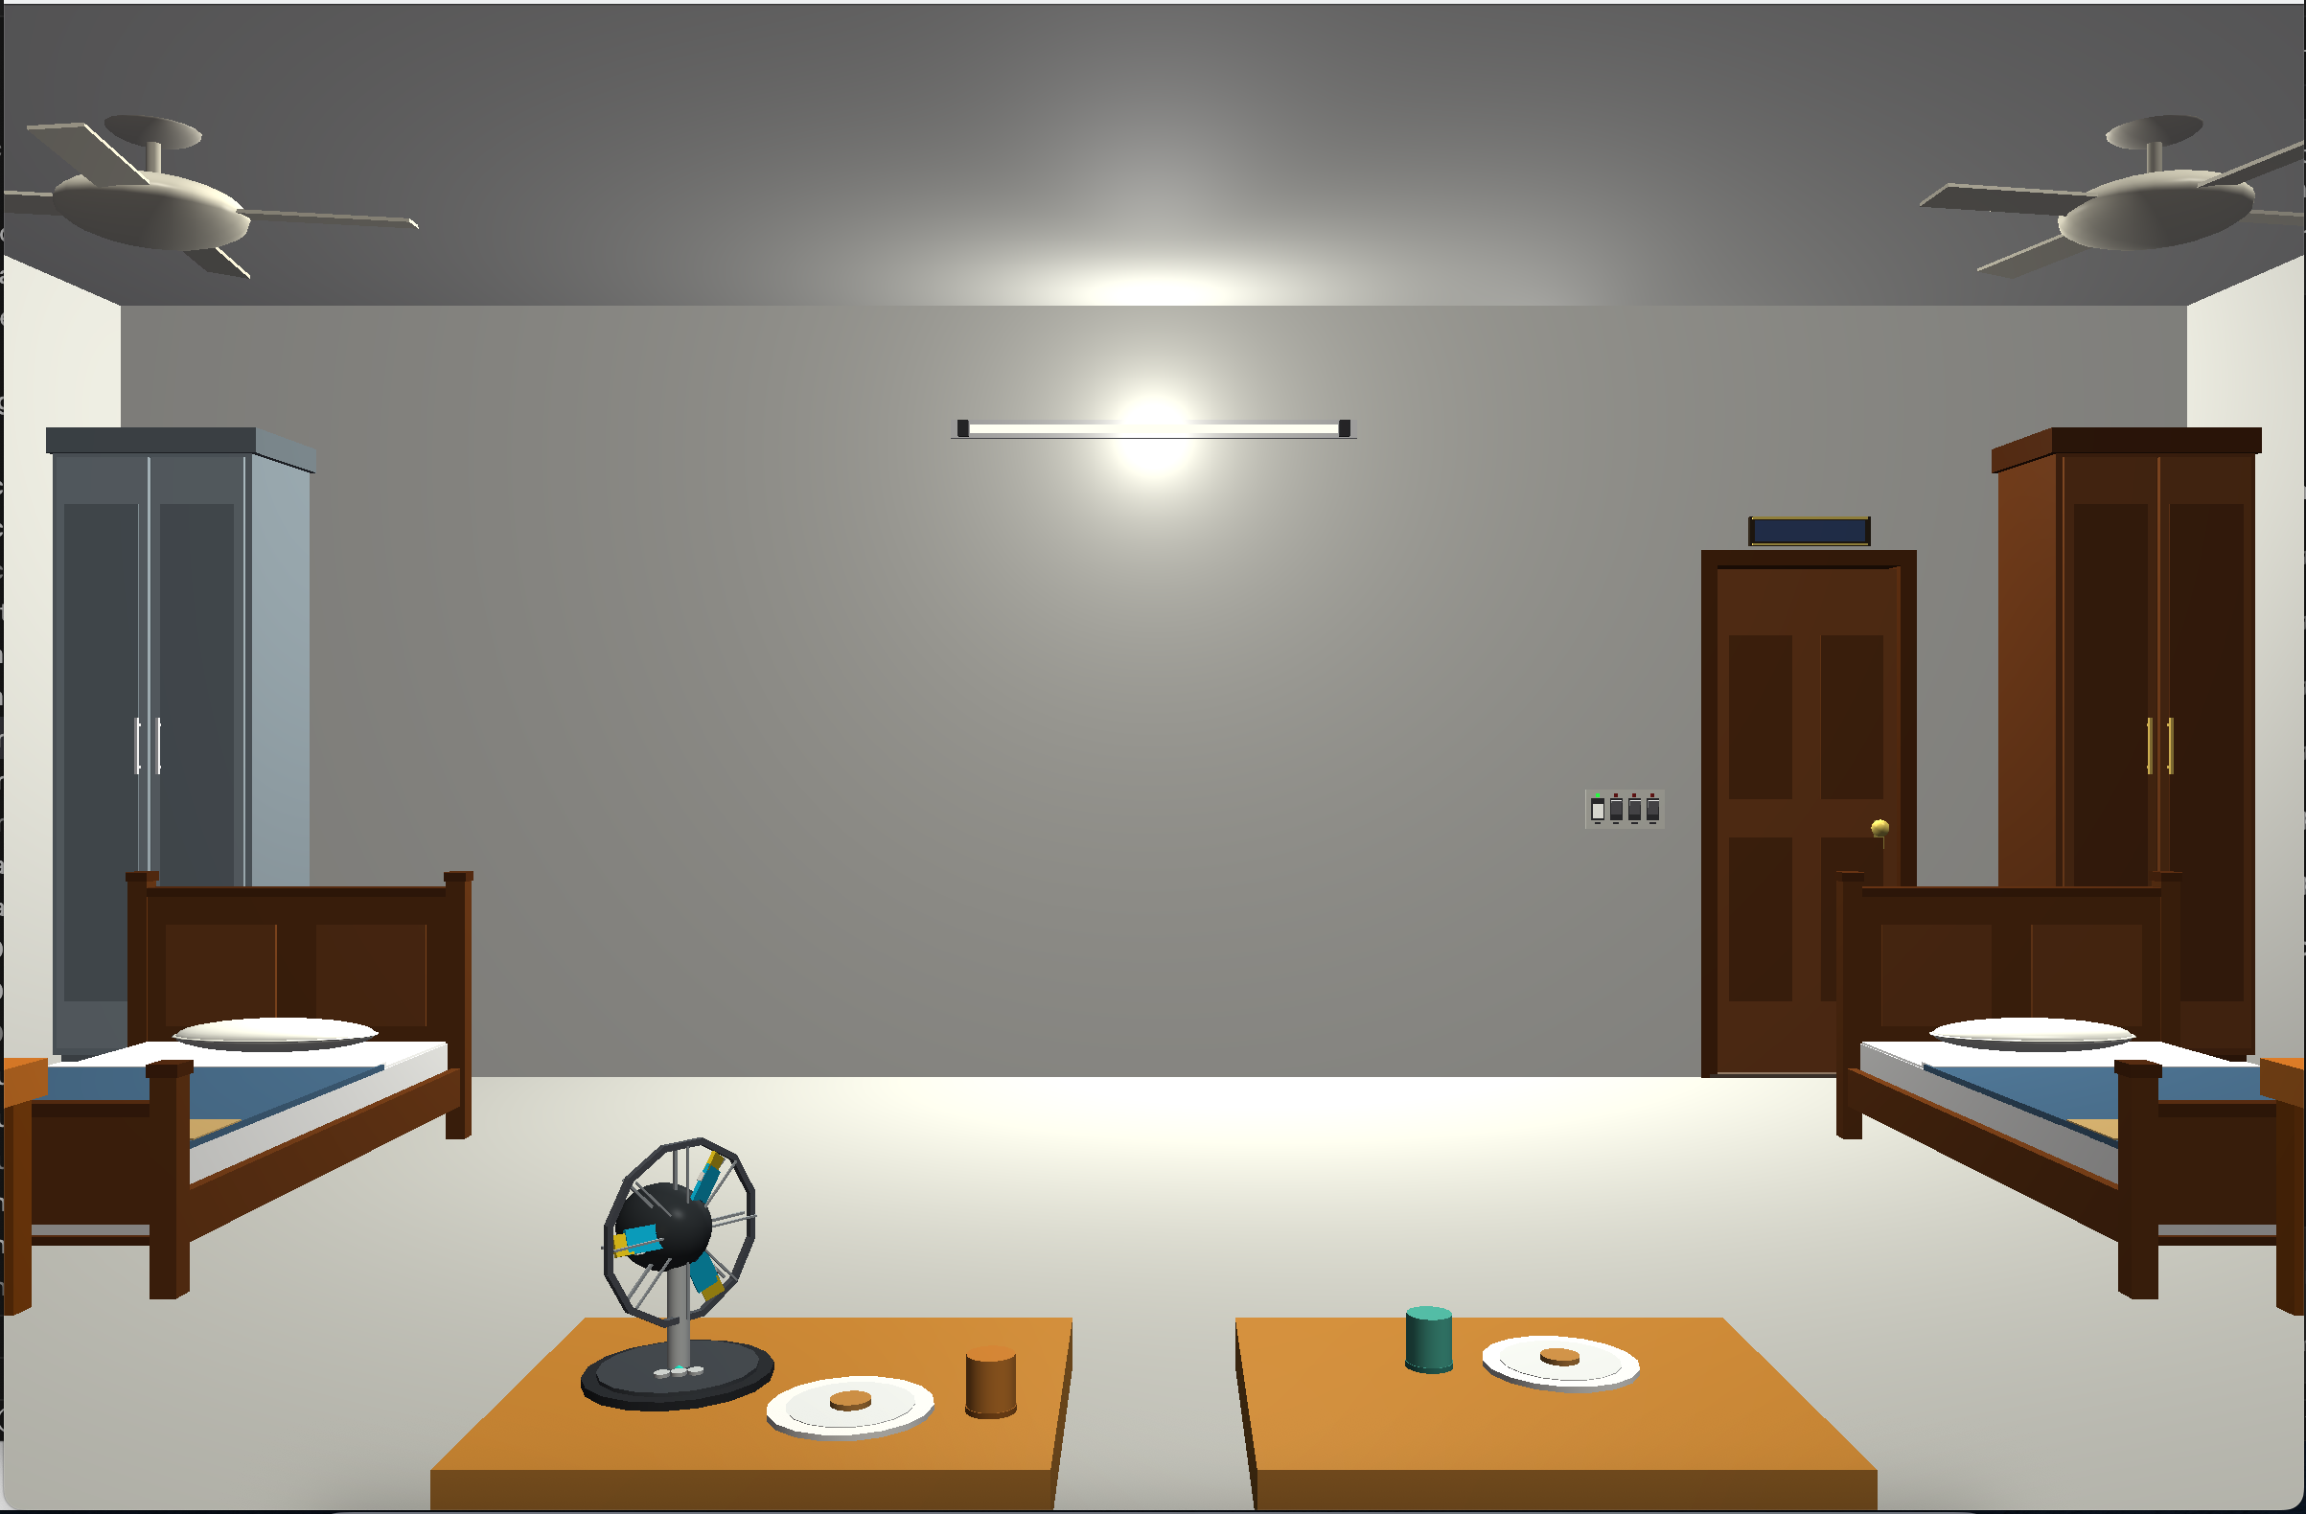
Introduction & Scene Architecture
Interactive collegiate hall walkthrough in Core Profile OpenGL 3.3
● ○ ○ ○ ○ ○ ○
1. Room 304 Interior
Room 304 Interior Rendering
▪ Dimensions: 16.0 × 6.0 × 18.0 units quadruple dorm room.
▪ 4 detailed wooden beds with recessed mattresses & trolley bags.
▪ 4 computing workstations with emissive PCs, CPUs & chairs.
2. Hallway Corridor Environment
▪ Enclosed hallway connecting dorms (302, 303, 305, 306).
▪ Anti-Z-fighting terrazzo runner (+0.02 offset above slab).
▪ Equipped with notice board, fire extinguisher & water dispenser.
3. Balcony Terrace & Quad Athletics
▪ Balcony terrace overlooking campus sports complex.
▪ 400m running track, soccer pitch, cricket pitch & wickets.
▪ Surrounding multi-story hall wings & four 30m floodlight masts.
Real-time Core Profile OpenGL 3.3 rendering displaying student beds, glowing PC monitors, and distance-attenuated point lighting (60.0 FPS).
Dept of CSE, KUET · October 2026
CSE 4102: Computer Graphics & Image Processing Lab
03 / 10

Slide 4
Procedural Primitive Computation
Foundational mathematical mesh generation without external CAD models
○ ● ○ ○ ○ ○ ○
Unit Cube (Axis-Aligned)
UV Sphere (Lat-Long Mesh)
Capped Cylinder
▪ Local Bounds: X, Y, Z in [-0.5, 0.5]
▪ Orthogonal Face Normals:
n = (±1, 0, 0), (0, ±1, 0), (0, 0, ±1)
▪ Tessellation: 6 faces × 4 vertices = 24
▪ EBO Optimization:
36 indices (144 B) vs 864 B (16.7% save)
▪ Parametric Surface Equations:
p(θ, φ) = (r sinθ cosφ, r cosθ, r sinθ sinφ)
▪ Analytical Gradient Normal:
n = ∇F / ||∇F|| = (x, y, z)
▪ 14 Stacks × 18 Sectors:
285 vertices, 468 triangles (1404 EBO)
▪ Side Wall Parametrics:
x = r cosθ, z = r sinθ, y in [-h/2, +h/2]
▪ Radial Side Normals:
n_side = (cosθ, 0, sinθ) on XZ plane
▪ Axial End Cap Fans:
78 vertices, 72 triangles (216 EBO)
Zero External CAD Model Principle
Procedural Assembly Application
▪ No external OBJ, FBX, or CAD models used anywhere in project.
▪ Total static cache: 387 vertices (15.5 KB) in GPU VRAM.
▪ Eliminates disk I/O latency for instant 60.0 FPS load time.
▪ Cube: Walls, doors, study desks, almirahs, CPU towers.
▪ Sphere: Fan motor hubs, foliage, light bulbs, door knobs, sun.
▪ Cylinder: Bed posts, chair legs, fan rods, cricket wickets.
Dept of CSE, KUET · October 2026
CSE 4102: Computer Graphics & Image Processing Lab
04 / 10

Slide 5
Transformations & Camera Navigation
Hierarchical matrix pipeline and collision-bounded first-person navigation
○ ○ ● ○ ○ ○ ○
1. Model Transformation Matrix (M)
2. Normal Matrix Transformation
▪ Matrix Formula: M = T(t) · R_y(θ) · S(s)
▪ Scale (S): Stretches unit 1x1x1 primitive to metric physical dimensions.
▪ Rotate (R): Orients primitive around local coordinate axes.
▪ Translate (T): Places assembled asset at world position.
▪ Matrix Formula: N_world = normalize( (M⁻¹)ᵀ · n_local )
▪ Geometric Distortion Problem: Non-uniform scaling (e.g. bed rails) destroys surface normal perpendicularity.
▪ Solution: Inverse-transpose maintains strict 90° normal orthogonality for photorealistic diffuse and specular lighting.
3. First-Person Camera Motion Vector
4. 3-Zone Portal Collision Logic
▪ Horizontal Walk Vector: D_walk = (D_x, 0.0, D_z) / ||·||
▪ Pitch-Independence: Stripping the Y component prevents slowing down or speeding up when looking up at ceiling or down at floor.
▪ View Matrix V: Look-At from camera position P_cam and vectors.
▪ Topological Zones: Balcony (z > 8.5), Corridor (z < -8.5), Room 304.
▪ Solid Boundary Enclosure: Walls strictly impassable by default.
▪ Doorway Portal Gate: Passing between zones permitted only if within doorway opening bounds AND door is swung open (θ > 10°).
Dept of CSE, KUET · October 2026
CSE 4102: Computer Graphics & Image Processing Lab
05 / 10

Slide 6
Multi-Source Illumination Model
Vector Phong reflection equations and distance-attenuated point light infrastructure
○ ○ ○ ● ○ ○ ○
I_total = k_a I_a + k_d I_d · max( N · L , 0 ) + k_s I_s · [ max( R · V , 0 ) ]^α
Where N is surface normal, L is light direction, R = 2(N·L)N - L is reflection vector, and V is view direction
Ambient (k_a · I_a)
Diffuse (k_d · I_d · (N · L))
Specular (k_s · I_s · (R · V)^α)
▪ Uniform scattered background light.
▪ Simulates secondary reflections.
▪ Prevents completely black shadows in unlit room corners and under beds.
▪ Lambert's Cosine Law for matte reflection.
▪ Scatters equally in all directions.
▪ Intensity scales with angle (N·L).
▪ Clamped at zero to avoid negative light.
▪ Glossy highlight when R aligns with V.
▪ Reflection: R = 2(N·L)N - L.
▪ Shininess exponent α = 32.0 controls sharp circular highlight size.
Quadratic Point Light Attenuation
7-Source Illumination Infrastructure
▪ Formula: f_att(d) = 1.0 / ( 1.0 + 0.055·d + 0.009·d² )
▪ Modulates diffuse and specular intensities over Euclidean distance d.
▪ Produces realistic soft drop-off for realistic indoor room illumination.
▪ L0: Directional Sun (-0.35, -0.85, -0.40), warm outdoor sky light.
▪ L1–L4: 4 distance-attenuated tube lights inside Room 304.
▪ L5 & L6: Corridor hallway tube light and warm balcony sconce light.
Dept of CSE, KUET · October 2026
CSE 4102: Computer Graphics & Image Processing Lab
06 / 10

Slide 7
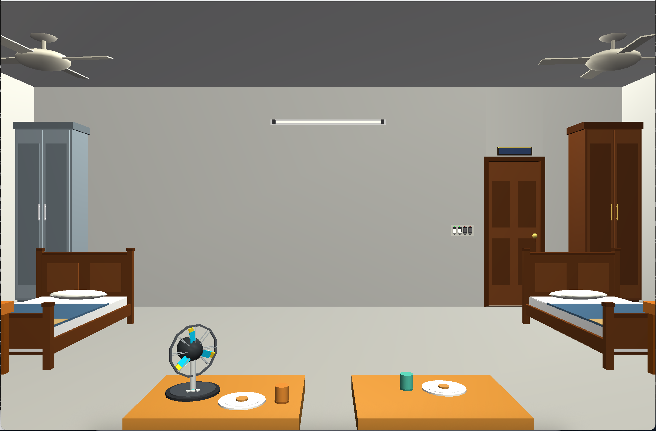
Shading Techniques: Gouraud vs. Phong
Runtime switchable per-vertex vs. per-fragment illumination comparison
○ ○ ○ ○ ● ○ ○
GOURAUD SHADING (Key G)
PHONG SHADING (Key P — Default)
Shader Execution Stage
Interpolation Mechanics
Specular Highlight Fidelity
▪ Gouraud: Evaluated in Vertex Shader (default.vert).
▪ Phong: Evaluated in Fragment Shader (default.frag).
▪ Gouraud: Hardware linearly interpolates vertex colors.
▪ Phong: Normal vector is interpolated per fragment, computing lighting at every pixel.
▪ Gouraud: Highlights clip or distort across large polygons.
▪ Phong: Sharp, circular, mathematically exact highlights on fans and bedposts.
Dept of CSE, KUET · October 2026
CSE 4102: Computer Graphics & Image Processing Lab
07 / 10

Slide 8
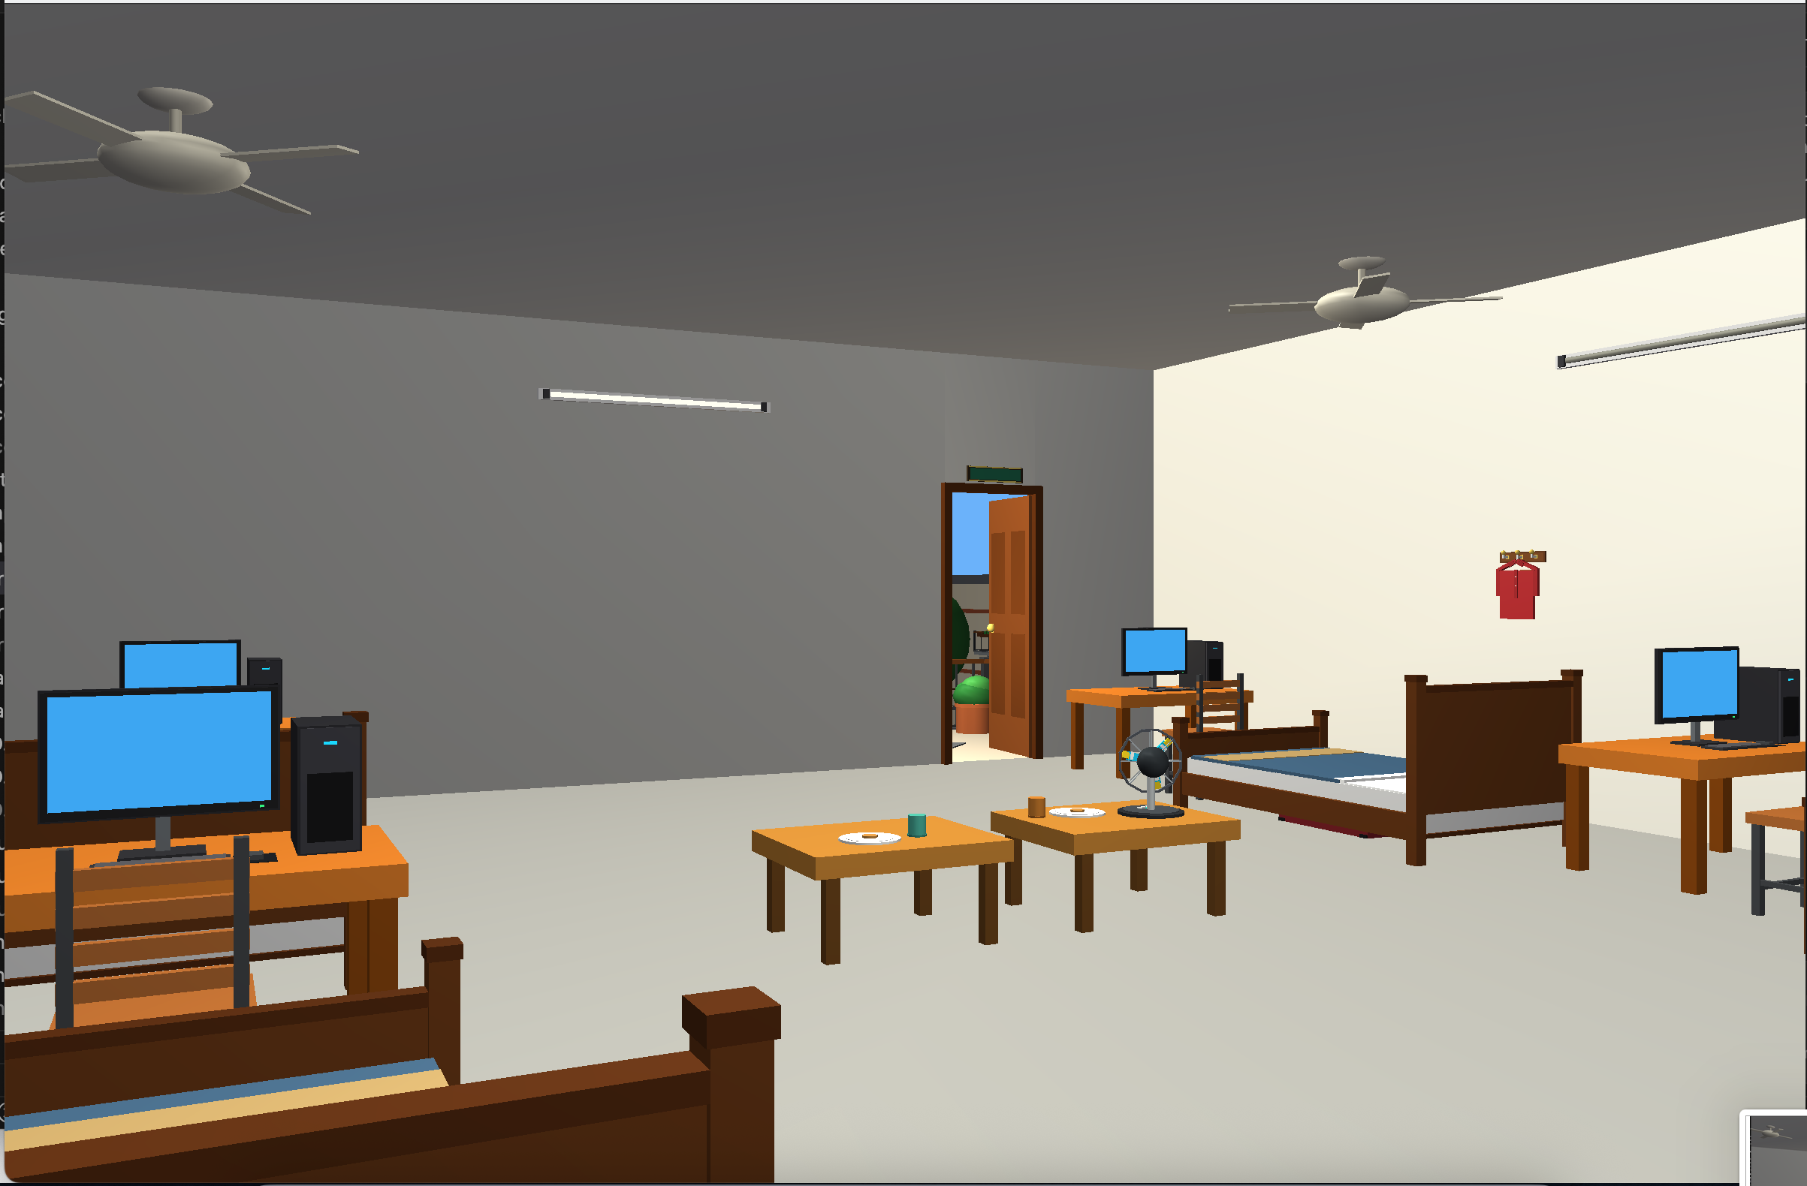
Dynamic Kinematics & Animations
Physics-driven motion, compound fan kinematics, and electrical switchboard
○ ○ ○ ○ ○ ● ○
1. Smooth Exponential Door Kinematics
Balcony Door Open Animation (Key O)
▪ Decay Law: θ(t+Δt) = θ + (θ_target - θ) · 5.0 · Δt
▪ Offset Hinge Pivot: M_door = T(p_h) · R_y(θ) · T(-p_h) · M_slab
▪ Keys O & M smoothly swing Balcony & Main Door to 95.0°.
2. Compound Dual-Motion Table Fan
▪ High-Speed Blade Spin: θ_blade = (θ + 880.0° · Δt) mod 360°
▪ Sinusoidal Case Oscillation: θ_case = 42.0° · sin( 1.8 · t )
▪ 4 ceiling fans simultaneously rotate continuously at 520.0°/s.
3. 4-Gang Electrical Switchboard Simulation
▪ Wall Switchboard: Mounted at eye level with 4 toggle switches.
▪ Live Status LEDs: Green when tube is active; Red when off.
▪ Key 0 deactivates all 4 room lights entering Dark Room State.
Interactive verification: Pressing key O smoothly opens the door 95°, unlocking camera portal passage to the outdoor balcony terrace and quad athletic field.
Dept of CSE, KUET · October 2026
CSE 4102: Computer Graphics & Image Processing Lab
08 / 10

Slide 9
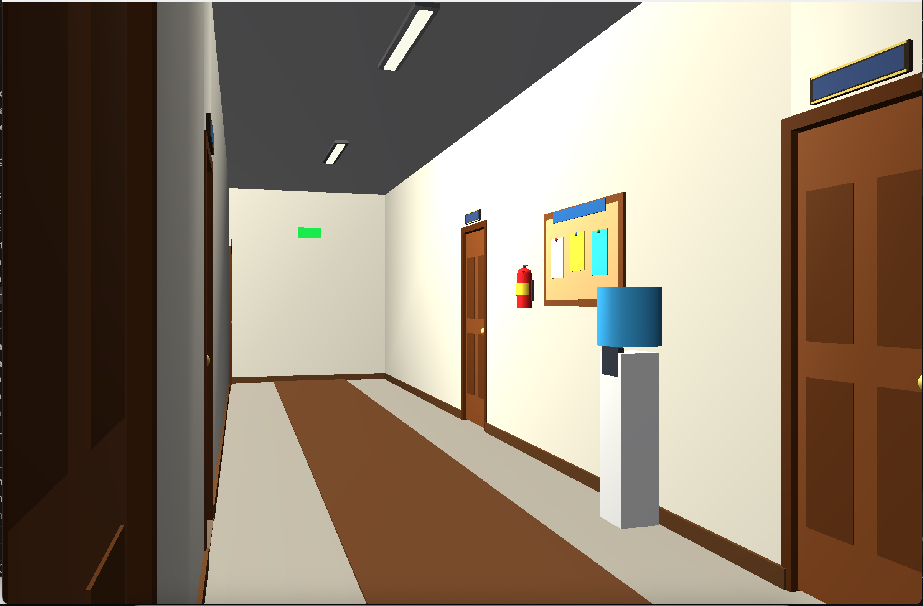
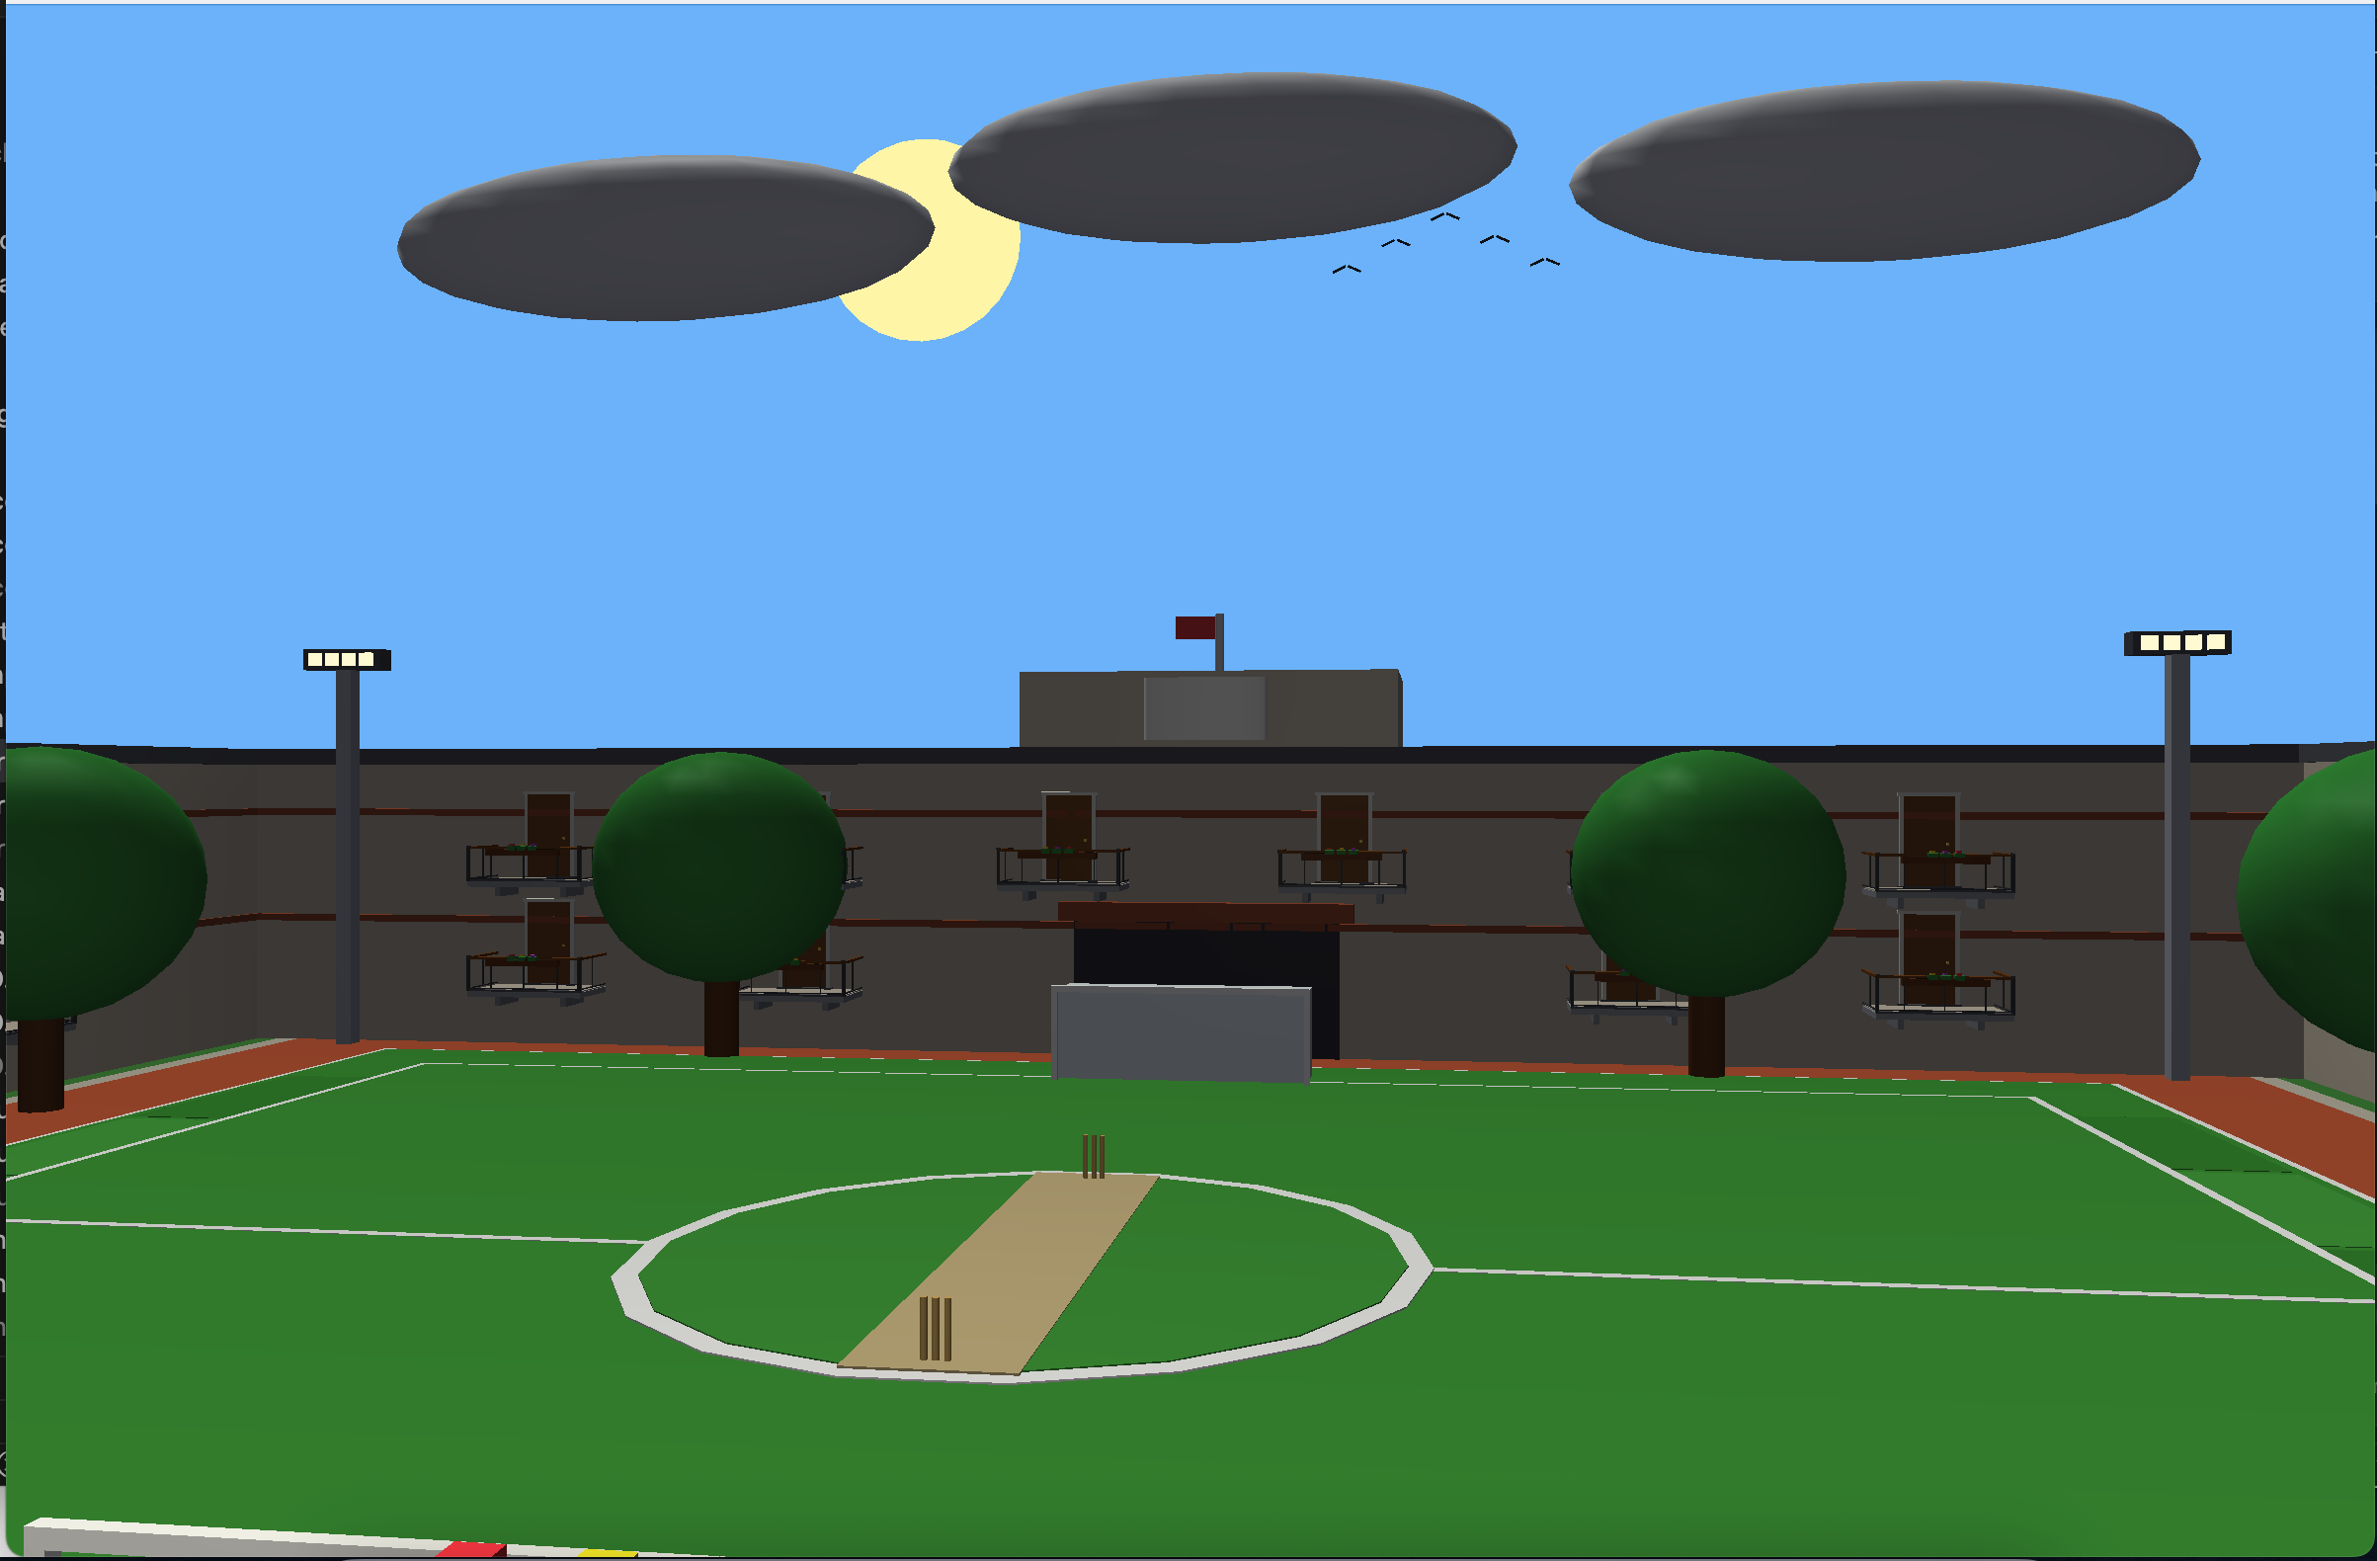
Architectural Showcase & Live Demo Guide
Corridor, balcony, and sports complex environment verification
○ ○ ○ ○ ○ ○ ●
Hallway Corridor (Terrazzo Runner & Notices)
Courtyard Sports Complex & Hall Wings
Step 1: Primitives
Step 2: Switchboard
Step 3: Shading
Step 4: Kinematics
Primitives.cpp
Keys 1, 2, 3, 4, 0
Keys G & P
Keys O & M
Explain Unit Cube, UV Sphere, and Cylinder mathematical mesh formulas and zero external CAD model dependency.
Toggle switches to demonstrate point light quadratic attenuation and live LED indicator changes; show Dark Room.
Press G to show polygonal highlight degradation; press P to restore per-fragment smooth Phong specular highlights.
Press O to swing balcony door 95° open; walk through doorway portal to explore track, cricket pitch & hall wings.
Dept of CSE, KUET · October 2026
CSE 4102: Computer Graphics & Image Processing Lab
09 / 10

Slide 10
Thank You!
1. 100% Procedural Synthesis
2. Multi-Source Illumination
Entire 3D world generated from mathematical equations (Cube, Sphere, Cylinder). Zero external CAD models.
Directional sunlight + 6 distance-attenuated point lights with runtime Gouraud & Phong shading toggles.
3. Dynamic Kinematics
4. Real-Time Performance
Smooth exponential door rotation, compound oscillating table fan, and 3-zone portal collision logic.
Stable 60.0 FPS rendering performance (under 2.10 ms GPU frame time) in Core Profile OpenGL 3.3.
Video Link : https://drive.google.com/drive/u/3/folders/1h7po6C9BaP7nm4oYQ_sWZM2QsQHm7IGa
Dept of CSE, KUET · October 2026
CSE 4102: Computer Graphics & Image Processing Lab
10 / 10

